Slide 1

Fundamentals of Onshore Drilling
Introduction to Onshore Drilling
presentation No. 1
references:
Bernt S. Aadnoy, Iain Cooper, Stefan Z. Miska, Robert F. Mitchell, Michael L. Payne: Advanced Drilling and Well Technology. SPE 2009, ISBN: 978-1-55563-145-1.
Robello G. Samuel, Xiushan Liu: Advanced Drilling Engineering – Principles and Design. Gulf Publishing Company, Houston Texas, 2009,
ISBN: 978-1-933762-34-0.
World Oil´s Handbook of Horizontal Drilling and Completion Technology.
Gulf Publishing Company, Houston, Texas 1991, ISBN: 0-87201-361-8.
A Primer of Oilwell Drilling. Petroleum Extension Service, Houston, Texas 2001, ISBN: 0-88698-194-8.
Robello, R. G.: Downhole Drilling Tools. Gulf Publishing Company, Houston, Texas
2007, ISBN: 978-1933762135.

Slide 2
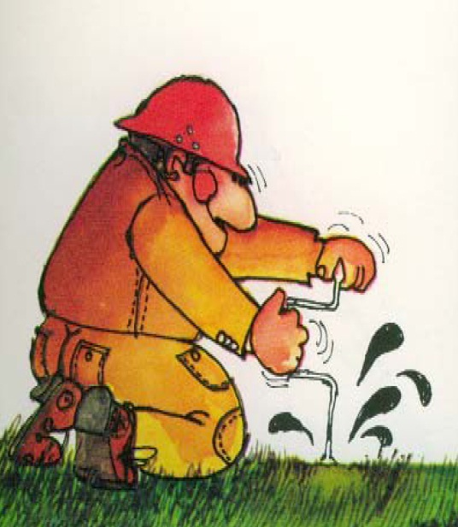
Fundamentals of Drilling
drilling means to make a hole in order to get access to the earth´s subsurface
Objectives may be
gaining information about the subsurface from sampling/testing/logging
=> hole discarded
production/injection of fluids/gases
(oil/gas/water)
=> hole completed into well
monitoring of subsurface properties
(aquifer preassure, stress state, etc.)
=> hole completed into well
objectives define hole/well construction

Slide 3
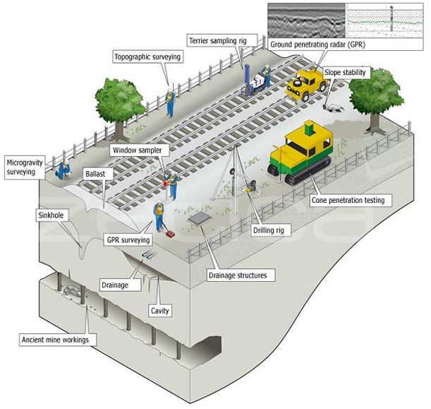
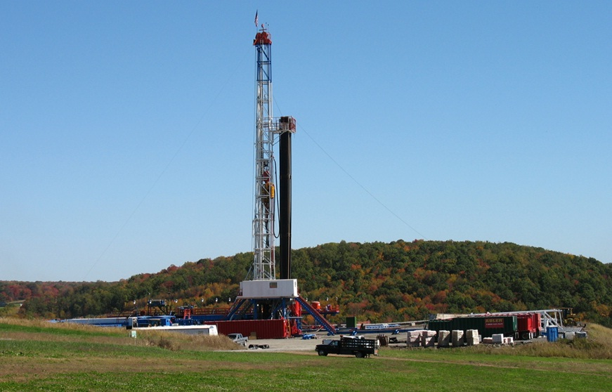
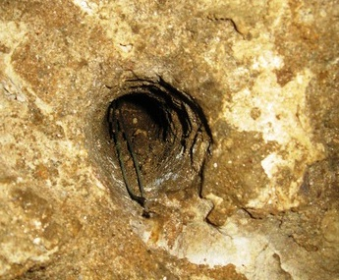
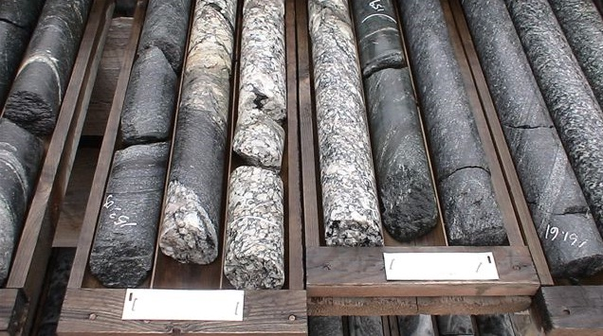
Fields of Drilling Applications
Exploration/Production of Natural Resources
- Oil and Gas
- Water
- Geothermal Energy
Site Investigation
- Scientific
- Foundation/Construction
- Environmental
Mining Exploration
Blast Hole/Seismic
- Quarry

Slide 4
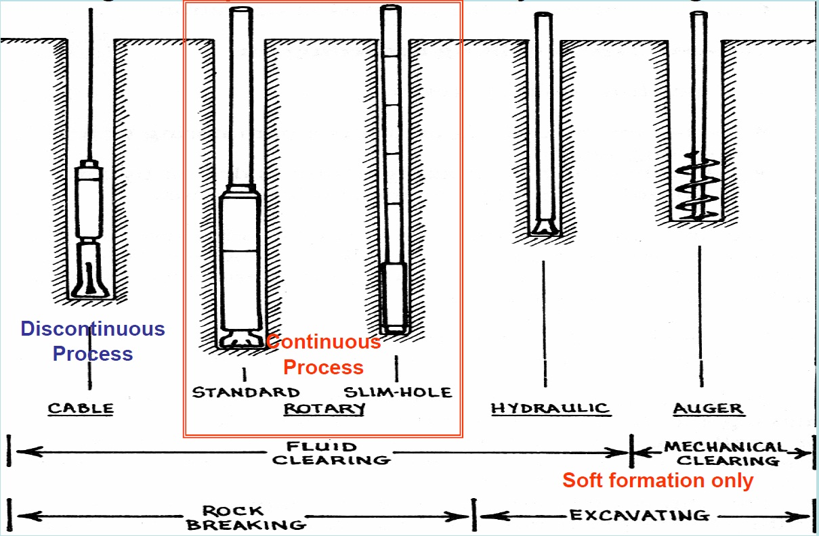
Drilling Techniques – Classification by Hole Making Methods

Slide 5
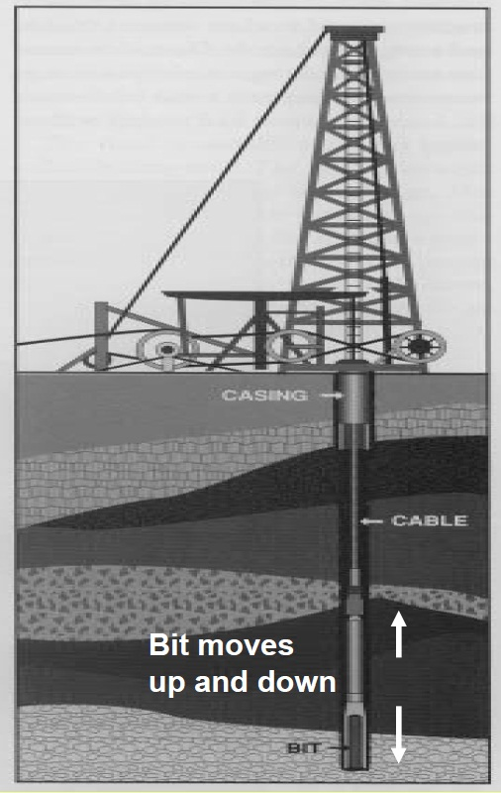
Principles of Drilling Techniques – Percussion Cabel Tool Drilling
very old drilling technique (applied more than 2000 years ago by the Chinese)
2 Phase Technique (discontinuous)
Phase 1: Rock Drilling
free falling bit strikes the bottom with a heavy blow – repeated lifting and dropping makes the bit drill
Phase 2: Removal of Cuttings
interruption of drilling to remove cuttings by bailing
suitable only for hard rock
total efficiency of drilling process is fairly low

Slide 6
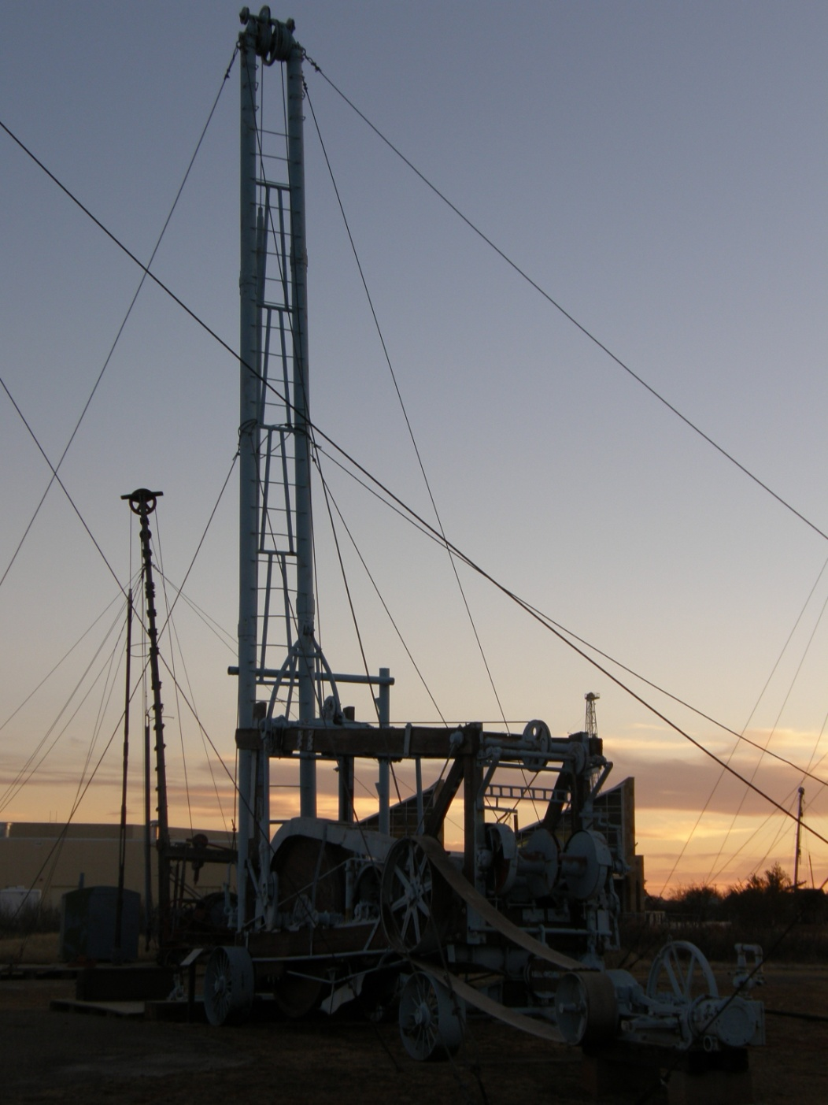
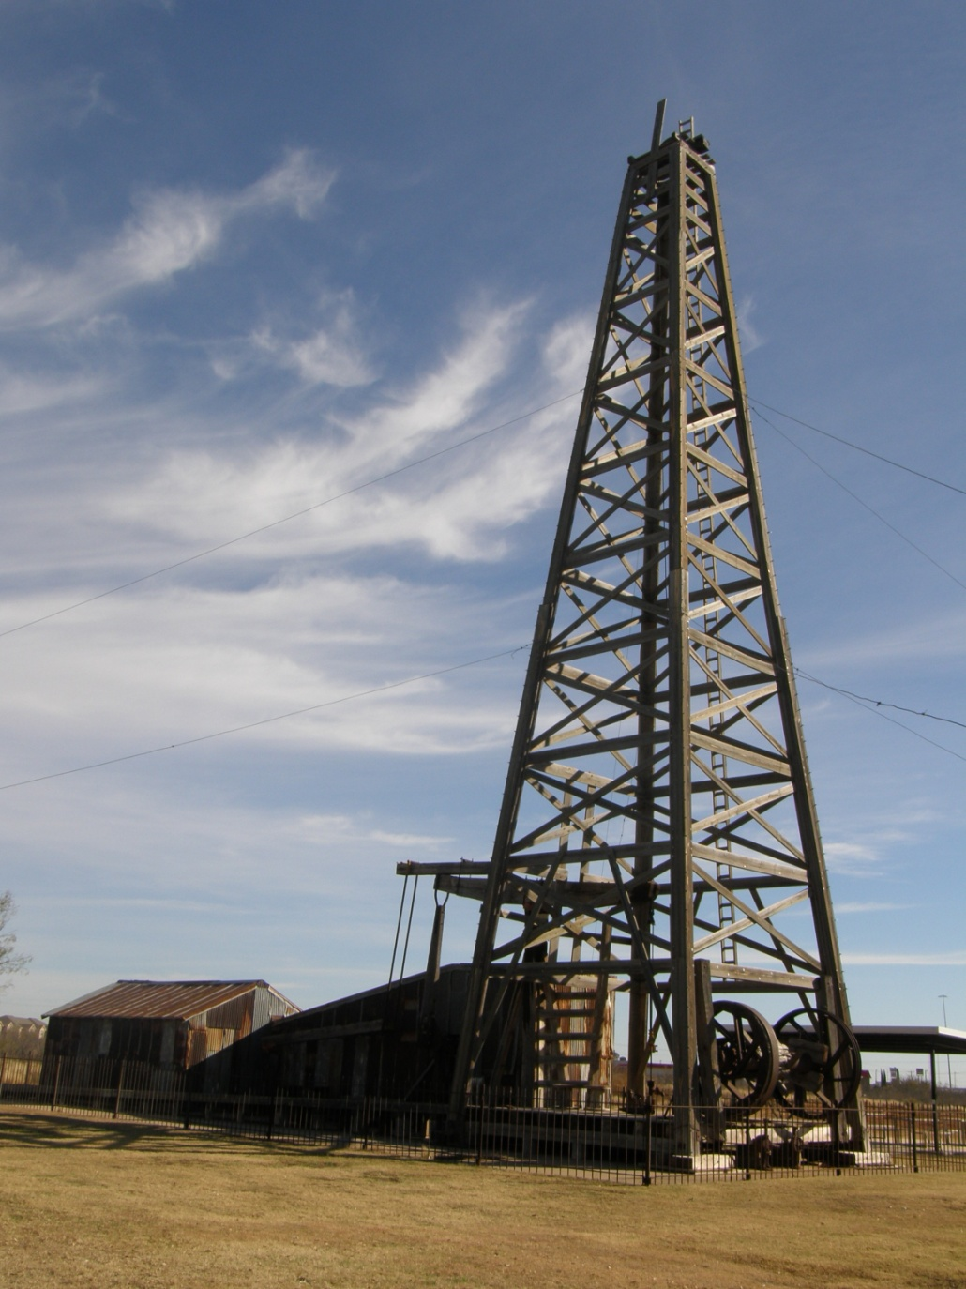
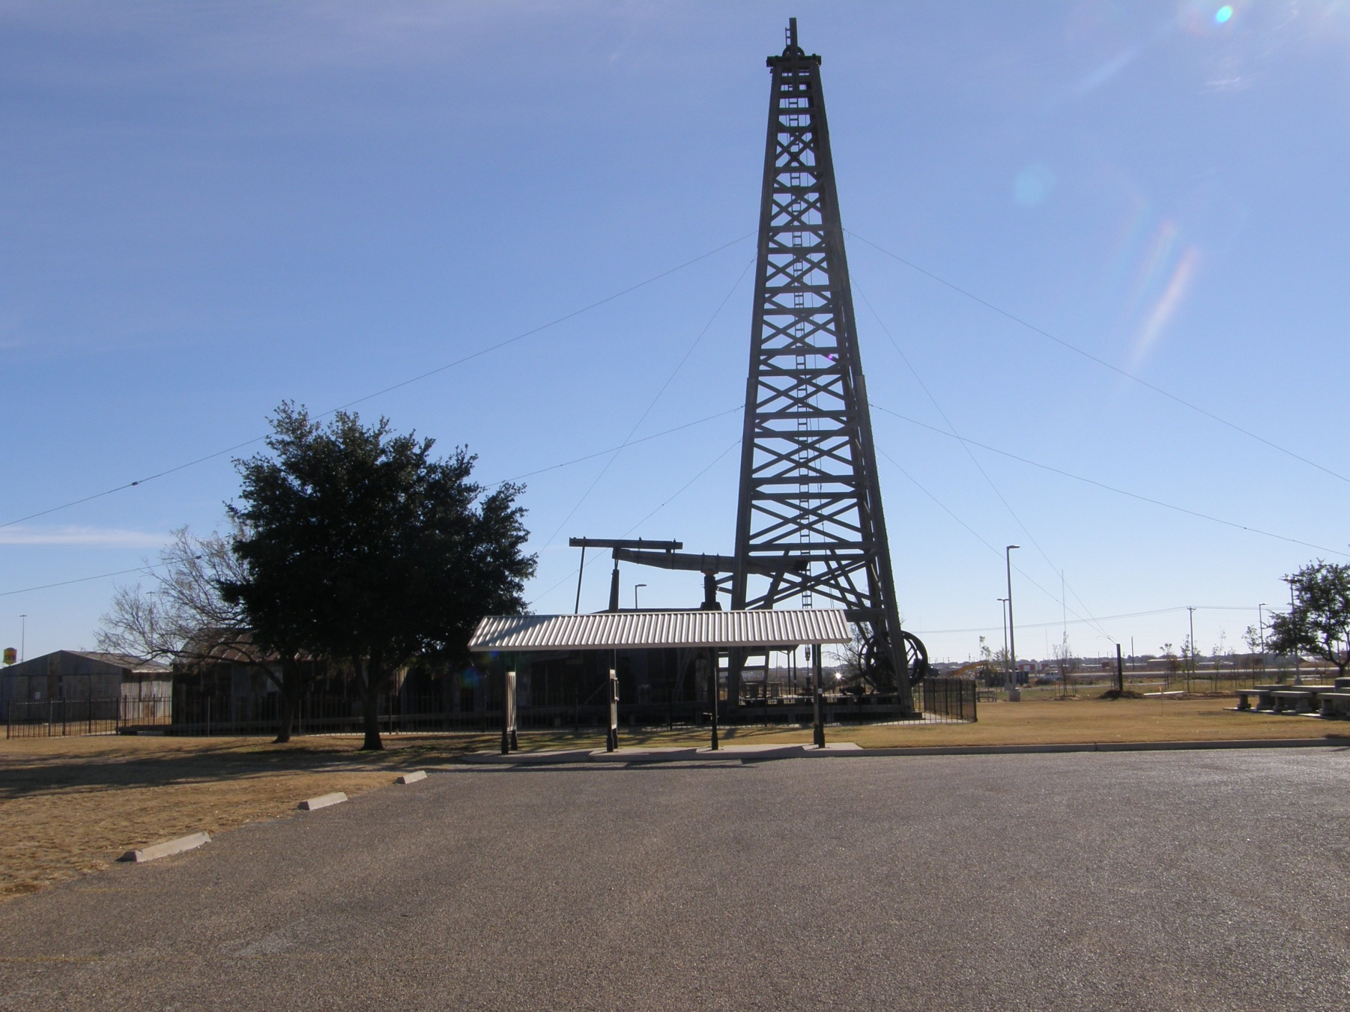
Principles of Drilling Techniques – Percussion Cabel Tool Drilling

Slide 7
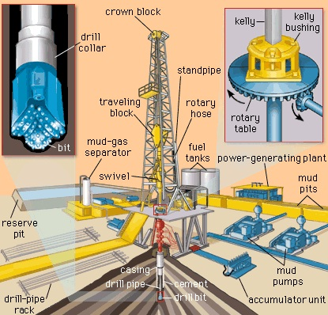
Principles of Drilling Techniques – Rotary Drilling
Drilling Fluid is circulated by being pumped down the drill string
The Drill String is rotated to turn the bit; it is fed down as the bit penetration
Bit is pushed into the bottom and rotation makes it cut
Return circulation carries cuttings up the annulus between the drill string and the wall of the hole
Key Elements:
- Drill Bit
Drill String
Drilling Fluid

Slide 8
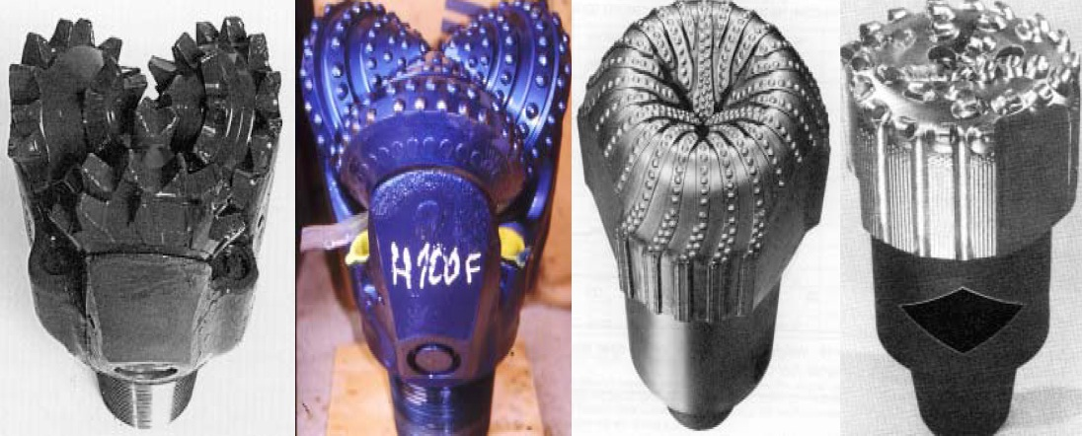
Types of Rotary Bits
Performance Parameters of Drill Bits: Penetration Rate (Drilling Speed: m/h)
Bit Life (Meters Drilled)
Rock Characterization
soft
very hard
medium hard
soft
Roller Cone Bit
Milled Steel Tooth
Roller Cone Bit
Tungsten Carbide
(inserts)
Diamond Bit
Natural Diamonds
Diamond Bit
Polycrystalline Diamond Compact Cutters

Slide 9
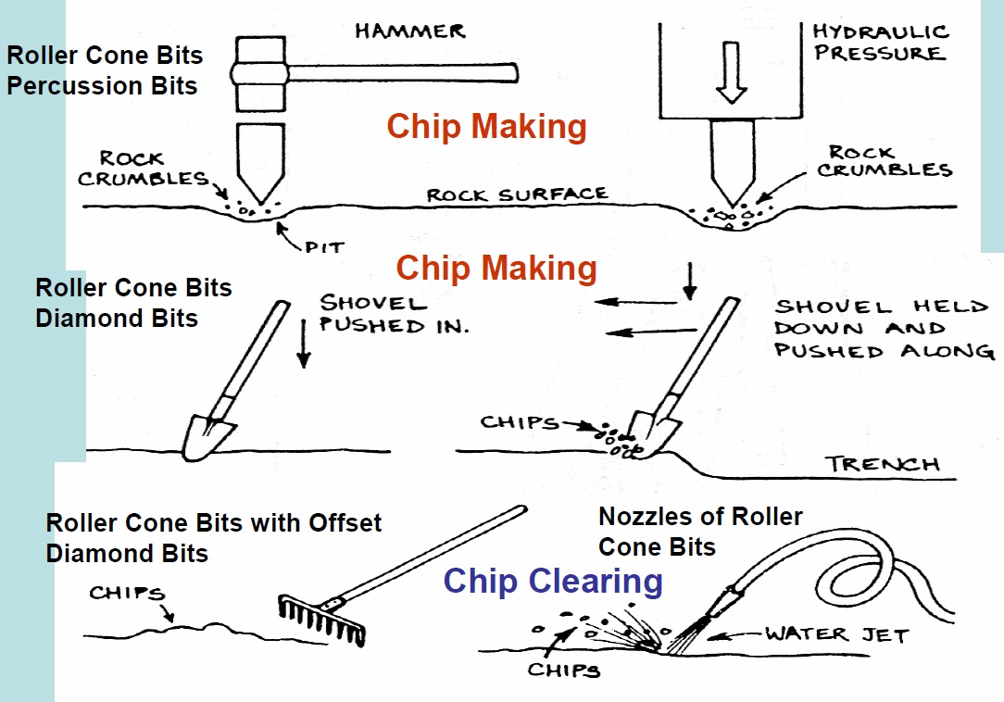
Cutting Action of Rotary Drill Bits

Slide 10
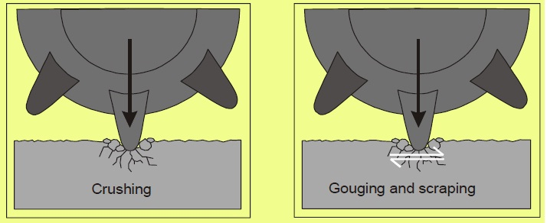
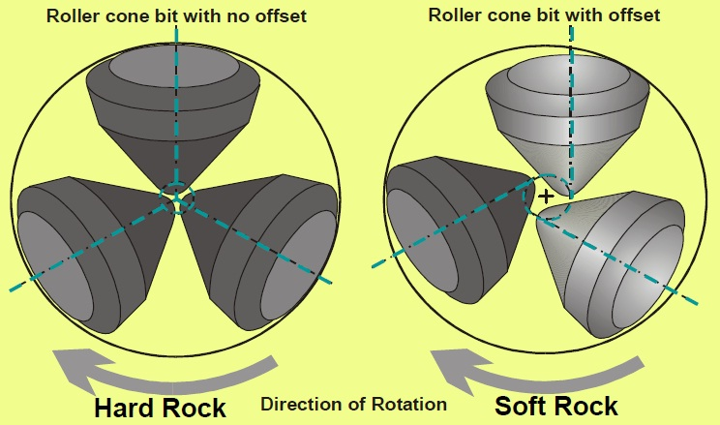
Cutting Action of Rotary Drill Bits
Cones of Roller Bits do only roll on the bottom but always
Slide, Tear and Gouge
Offset of cones increases
Sliding, Tearing, Gouging action

Slide 11
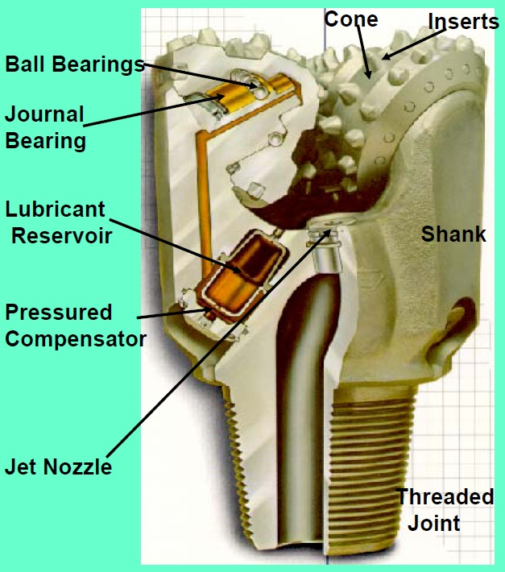
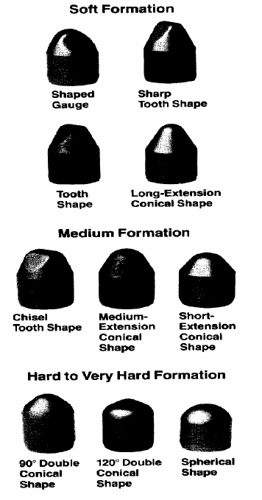
Elements of Roller Cone Bits
Shape Types of Inserts

Slide 12
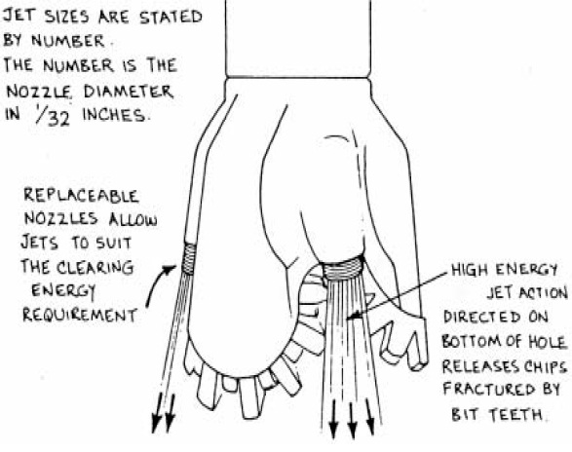
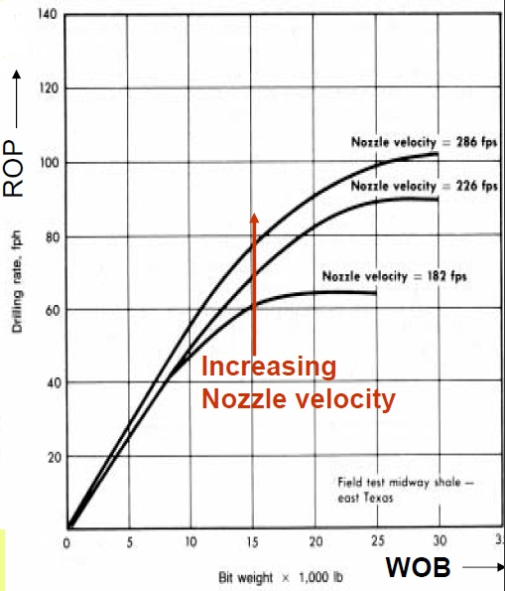
Bottom Hole Cleaning of Roller Cone Bits
Schematic of Nozzles Action
Effect of Nozzle Velocity on Rate of Penetration

Slide 13
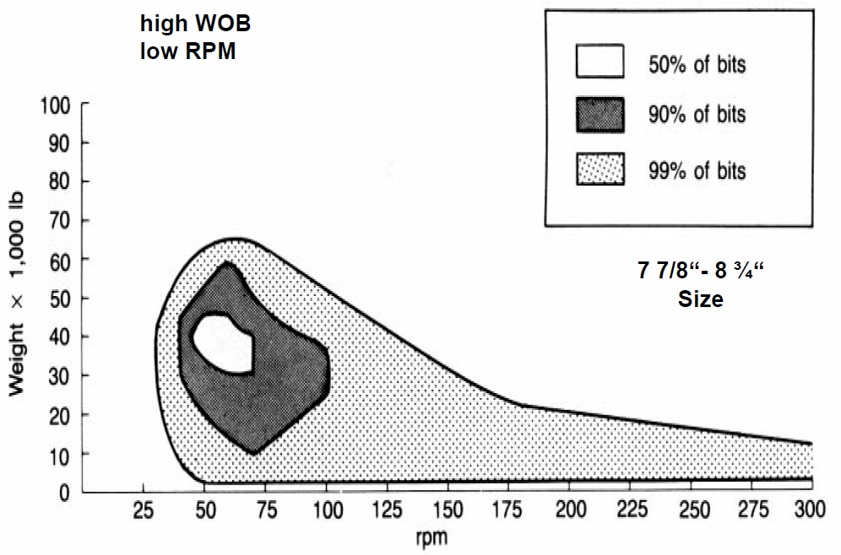
Typical Operating Parameters for Roller Cone Inserts Bits

Slide 14
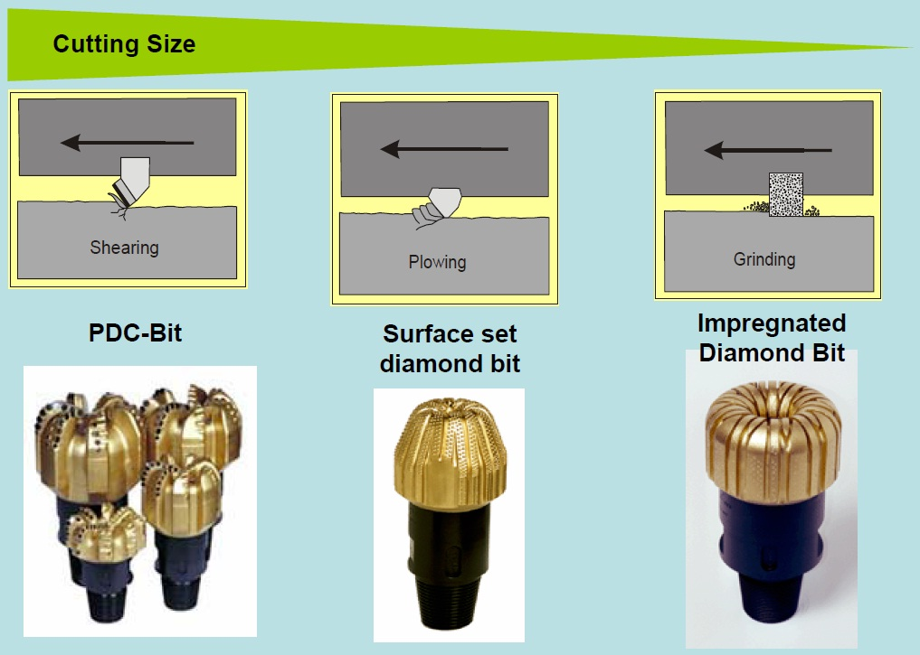
Cutting Action of Diamond Bit

Slide 15
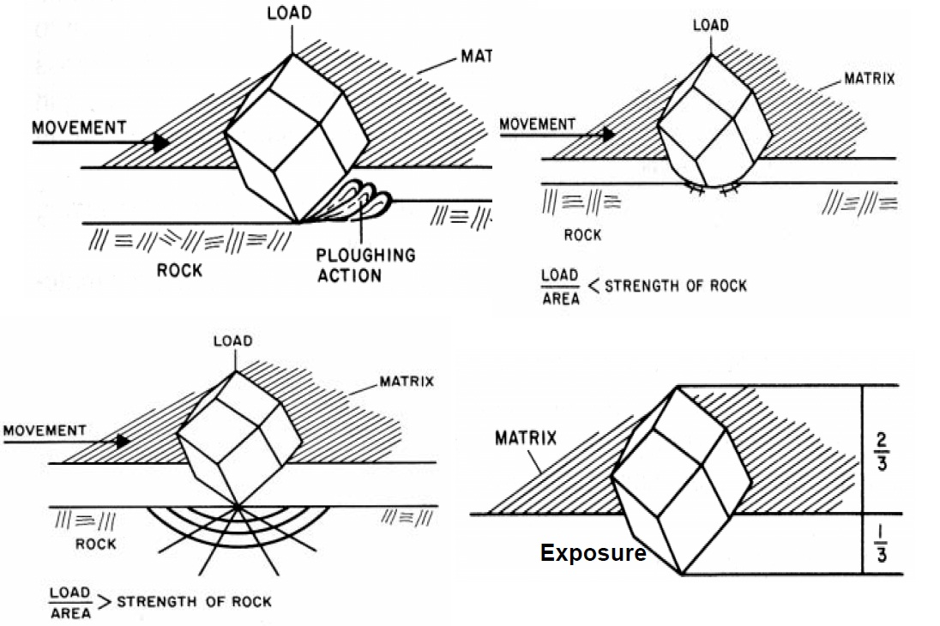
Cutting Action of Diamonds

Slide 16
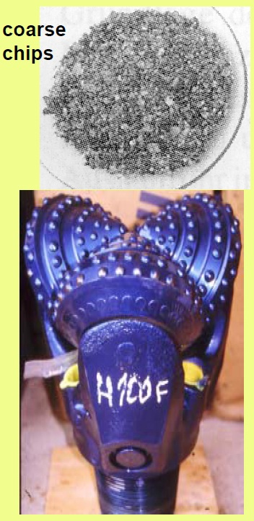
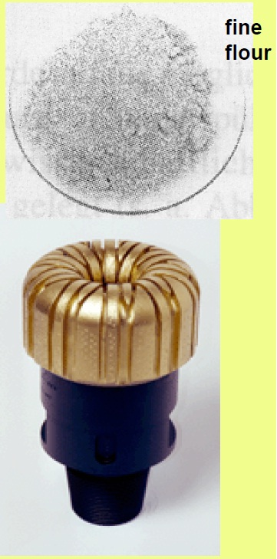
Sizes and Texture of Hard Rock Cuttings Dependent on Bit Type

Slide 17
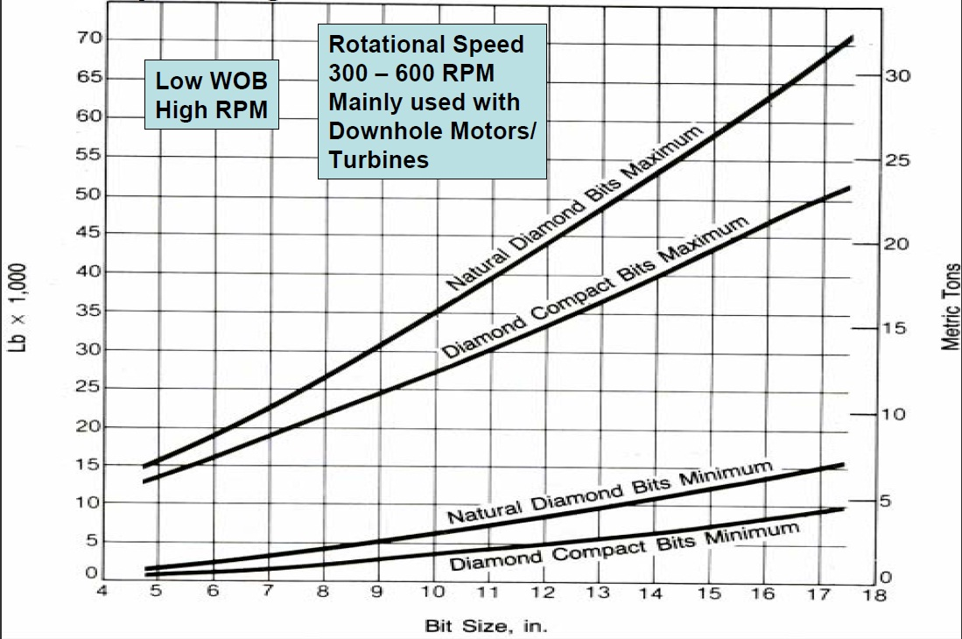
Operating Parameters of Diamond Bits

Slide 18
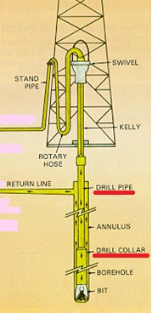
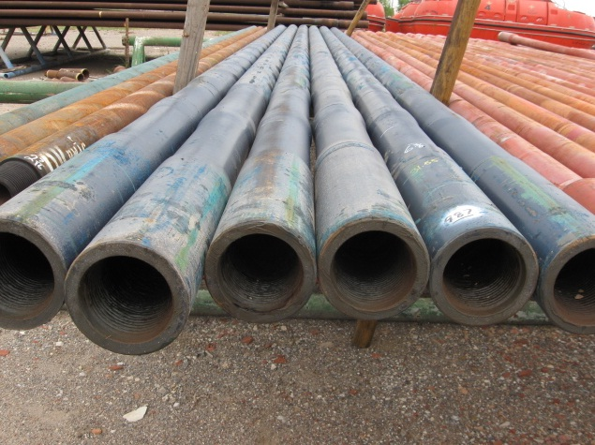
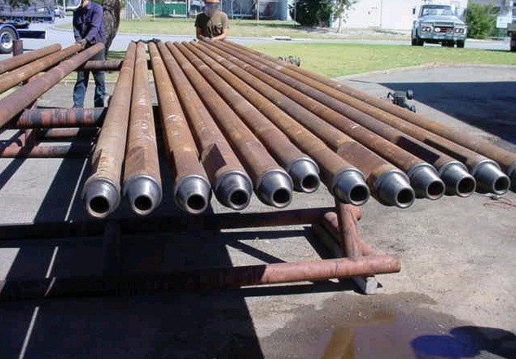
Typical Rotary Drill String Assembly
The drill string is the mechanical assemblage connection the rotary drive on surface to the drilling bit on bottom of the hole
Functions of the Drillstring:
flow line for circulating drilling fluid
provides weight on bit
transmits rotation and torque to bit
guides and controls trajectory of the bit
Main Components:
Drill Collars: thick wall steel pipe with Pin/Box threaded connection
Drill Pipe: steel pipe with Pin/Box threaded toolioints
Ancillary Components:
crossover subs
stabilizers
reamers

Slide 19
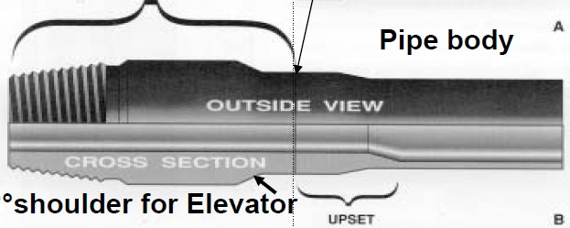
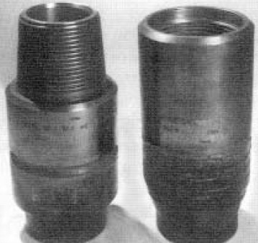
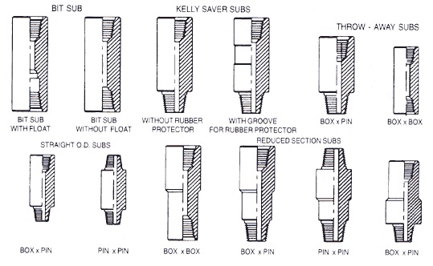
Rotary Drillpipe Characteristics
Tooljoint
Welded
Pin and Box Tooljoint
18
Rotary Drillpipes are standartized by API
Outer Diameter
of Pipe Body
Steel Grades of
Pipe Body
Nominal Weight of Pipe Body
Pipe Lenght
5 ½“
5“
4 ½“
4“
3 ½“
2 7/8“
2 3/8“
E – 75
X – 95
G – 105
S - 135
Range 1: 18 – 22 ft
Range 2: 27 – 30 ft
Range 3: 38 – 45 ft
Wall Thickness
1 ft = 30,48 cm
Tool Joints Steel Grade: 120 000 psi (827,4 Mpa)
Thread Type: NC 50, NC 38
Friction welded with upset pipe body annealed and machined
1“ = 2,54 cm

Slide 20
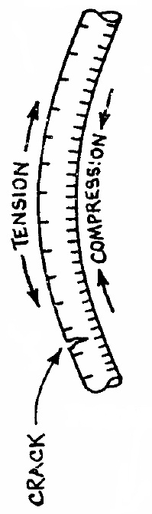
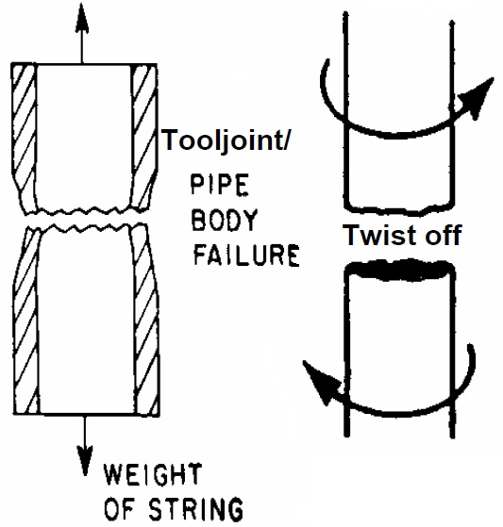
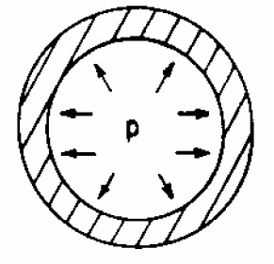
Drill Pipe Problems
Bending
(While Rotation)
Drill pipe is the most stressed component of rotary equipment!!!
Reversal Stresses
Tension
Torque
Burst
(Inside Pressure)
Fratigue

Slide 21
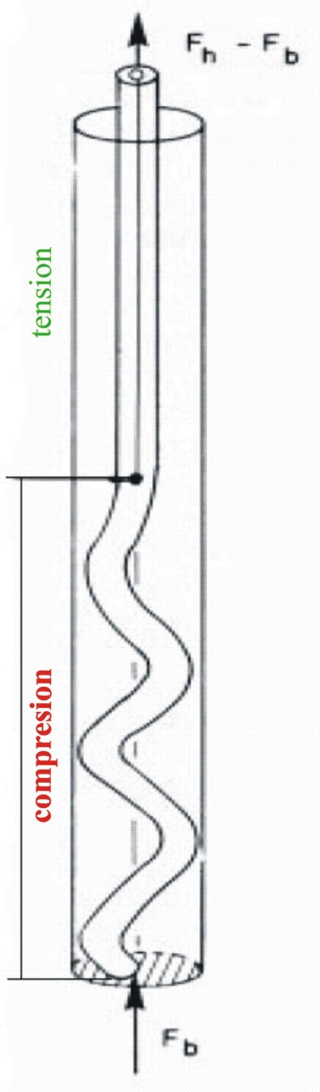
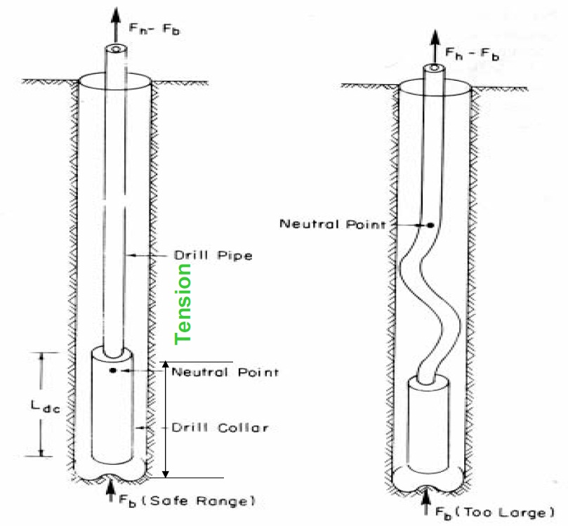
Putting Weight on Bit by Drill Collars
Buckling of Drillpipe under Compressional Load!

Slide 22
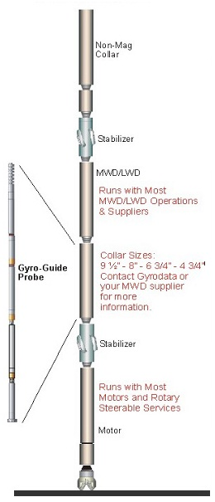
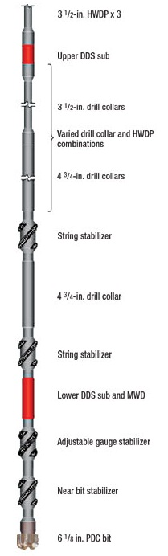
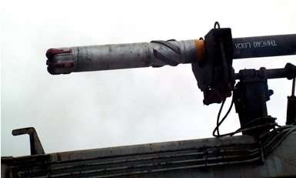
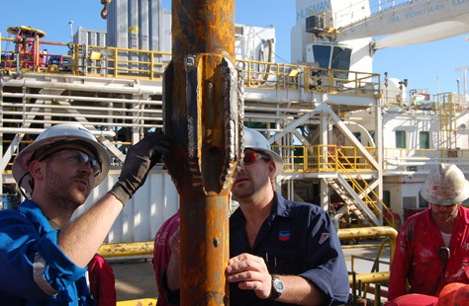
Typical Examples for Stabilized
Bottom Hole Assemblies (BHA)

Slide 23
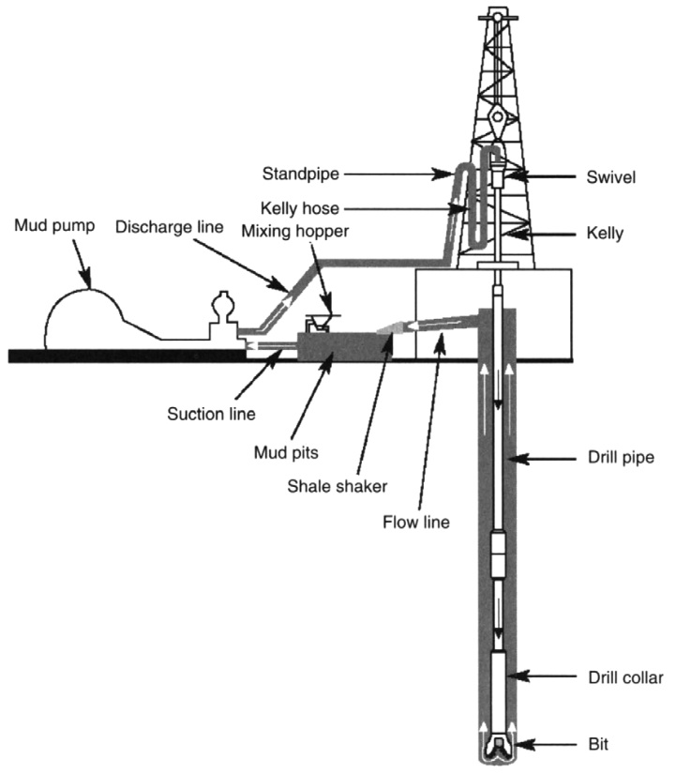
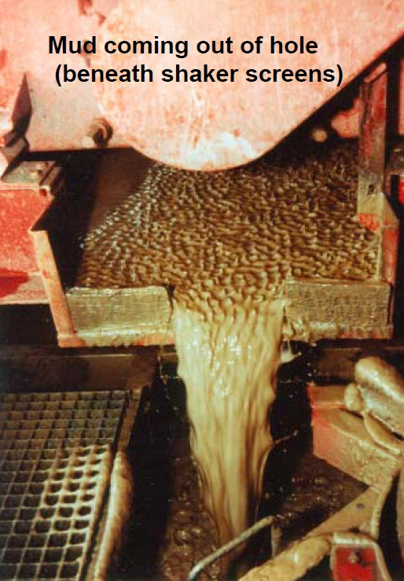
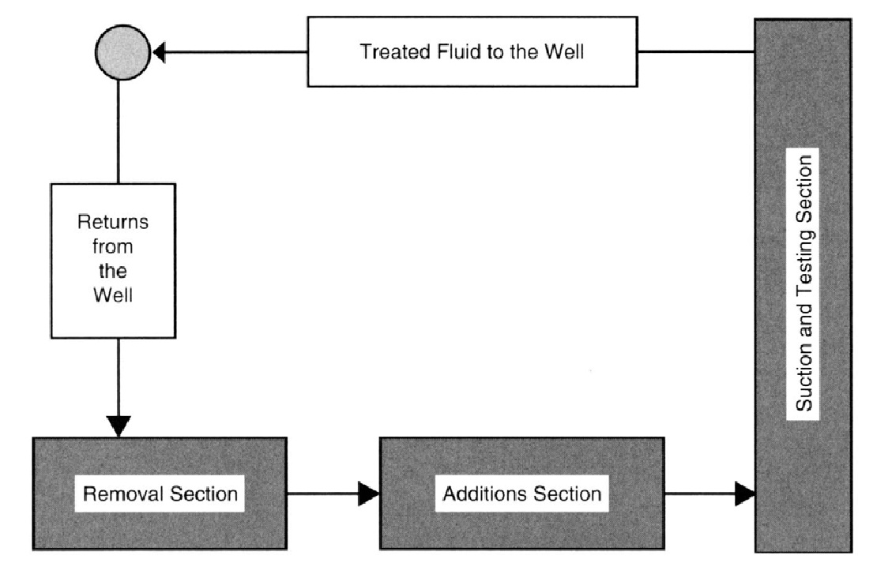
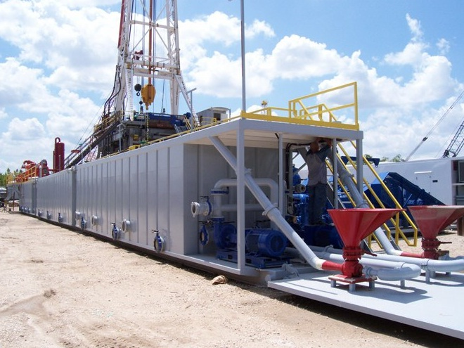
Drilling Fluid – Why it´s Called MUD

Slide 24
Drilling Mud – A Multipurpose Fluid
Major Functions:
Bottomhole Cleaning
Cuttings Transport
Borehole Wall Support
Balancing Formation Pressure
Cooling the Bit
Hydraulic Power Transmission
Data transmission (MWD)
Reducing Friction
Corrosion Protection
Scientific Information Carrier

Slide 25
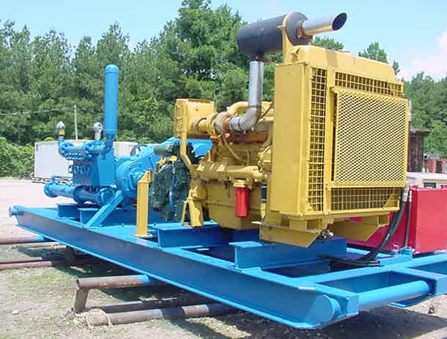
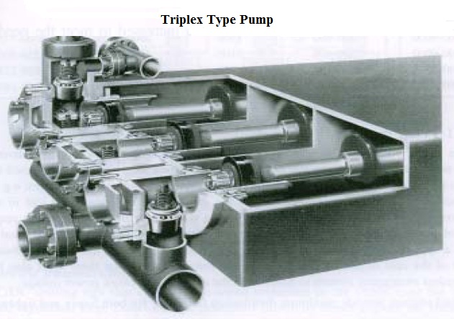
Drilling Fluid Circulating Pumps
Typical Operating Parameters:
max pressure: 35 Mpa
17 ½“ = 3 500 l/min
12 ¼“ = 2 500 l/min
8 ½“ = 1 500 l/min
6“ = 600 l/min
heavyweight rigs =>
2 pumps 1 200kW
lightweight rigs =>
2 pumps 600 kW

Slide 26
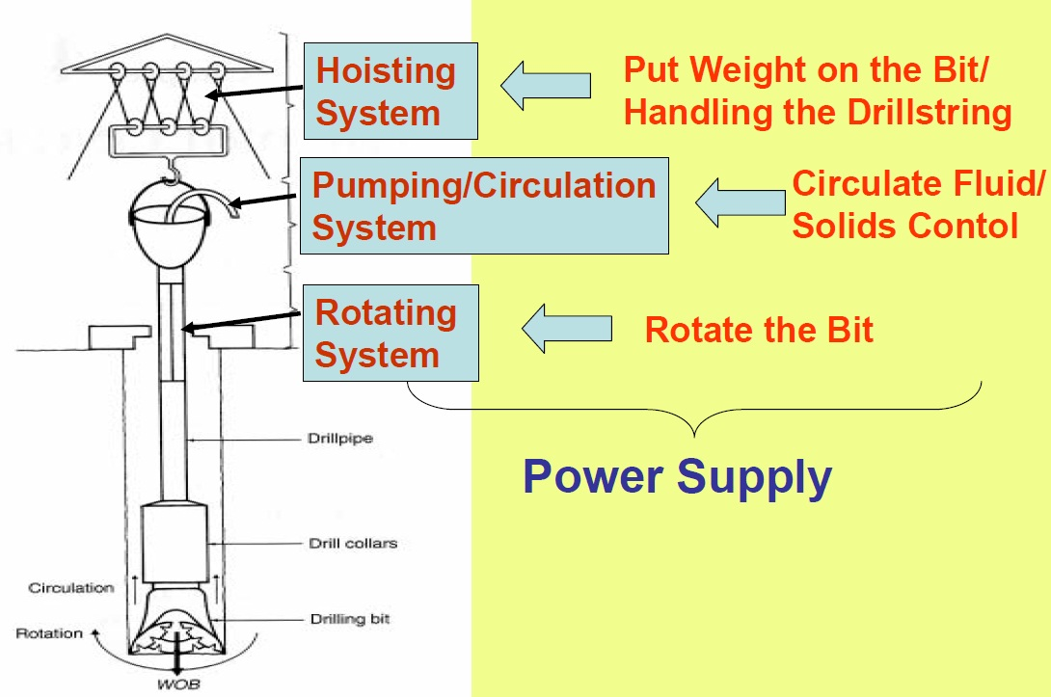
Principal Functions of a Rotary Drilling Rig

Slide 27
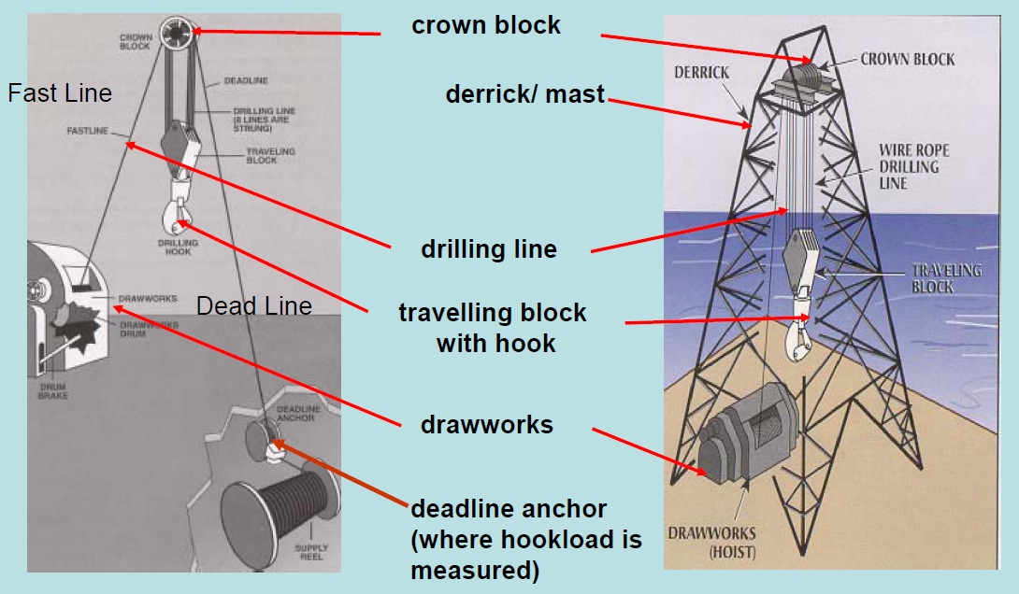
Main Components of the Hoisting System

Slide 28
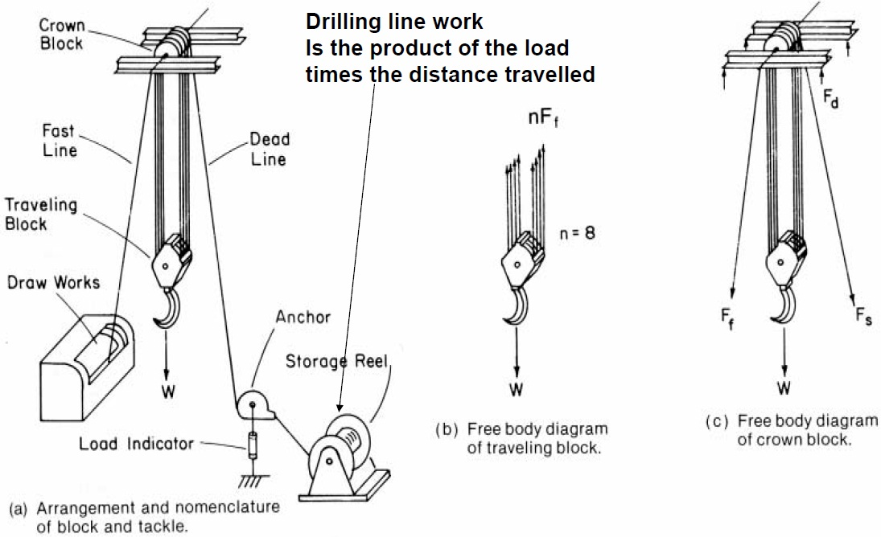
Schematic of a Rotary Rig´s Block and Tackle

Slide 29
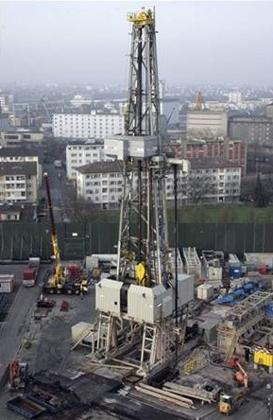
Hoisting System of Drilling Rigs – Hoisting Tower
Derrick
Structural tower assembled/
dismantled piece by piece
Assembling/
dismantling is time consuming
Used mainly offshore
Square shaped rig floor

Slide 30

Hoisting System of Drilling Rigs – Hoisting Tower
Mast
A-shaped structure which can be pulled or lowered to a upright position by the drawworks without completely assembling or disassembling
Good mobility
Used mainly with onshore rigs

Slide 31


Rotary Rig Drawworks
Advantages of Gear Driven Drawworks:
high performance
high availability
less noise
less vibration
increased safety

Slide 32




Rotating the Drillstring with a Rotary Table

Slide 33


Rotating the Drillstring with a Top Drive
TOP DRIVE means a Power Swivel which directly turns the drillstring without need for a kelly and rotary table
Advantages of a Top Drive Systém:
drill string can be pulled out while rotating and circulating → Back Reaming
can be reconnected to the drill string at any mast height during tripping
drilling with 3-joint stands of drill pipe is possible
with hydraulic driven power swivel static torque can be applied for much longer time
Save time!!!
Safer and easier operation!!!

Slide 34

Drilling Rig – LOC 400

Slide 35


Slide 36


Slide 37
Classification of Drilling Rigs
Classification by Depth Rating:
lightweight rigs: 1 500 – 2 000 m
intermediate rigs: 3 500 m
heavyweight rigs: 6 000 m
ultraheavy rigs: 8 000 – 10 000 m
Classification by Horsepower:
Rule of Thumb:
every 100 ft (30,5 m) of borehole requires 10 HP (7,5 kW) at drawworks
lightweight rigs : 650 HP (484,7 kW)
intermediate rigs : 1 300 HP (969,4 kW)
heavyweight rigs : 2 000 HP (1491 kW)
ultraheavy rigs : 3 000 HP (2 237 kW)

Slide 38

Typical Rig Organization Scheme

Slide 39



Drilling Contracts

Slide 40

THE END!!!

