Slide 1

Fundamentals of Onshore Drilling
Fundamentals of Drilling
Fishing –
Stuck Pipe Problems
presentation No. 4
references:
Bernt S. Aadnoy, Iain Cooper, Stefan Z. Miska, Robert F. Mitchell, Michael L. Payne: Advanced Drilling and Well Technology. SPE 2009, ISBN: 978-1-55563-145-1.
Robello G. Samuel, Xiushan Liu: Advanced Drilling Engineering – Principles and Design. Gulf Publishing Company, Houston Texas, 2009,
ISBN: 978-1-933762-34-0.
Joe DeGeare, David Haughton, Mark McGurk: The Guide to Oilwell Fishing Operations (Tools, Techniques and Rules of Thumb). Gulf Drilling Guides, Houston, Texas, 2009, ISBN: 978-0-7506-7702-2.
A Primer of Oilwell Drilling. Petroleum Extension Service, Houston, Texas 2001, ISBN: 0-88698-194-8.
Robello, R. G.: Downhole Drilling Tools. Gulf Publishing Company, Houston, Texas
2007, ISBN: 978-1933762135.

Slide 2
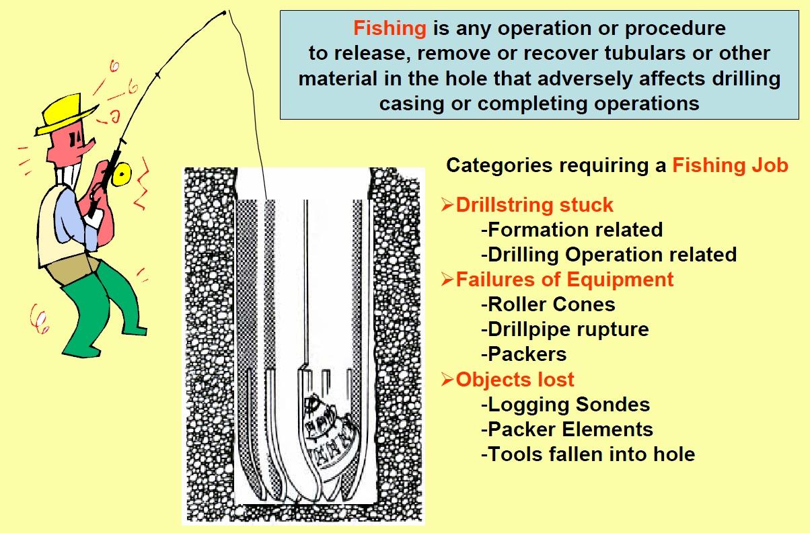
Causes for Fishing Operations

Slide 3
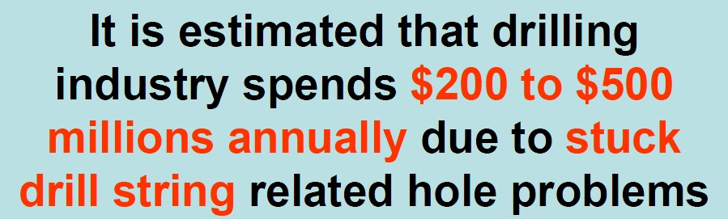
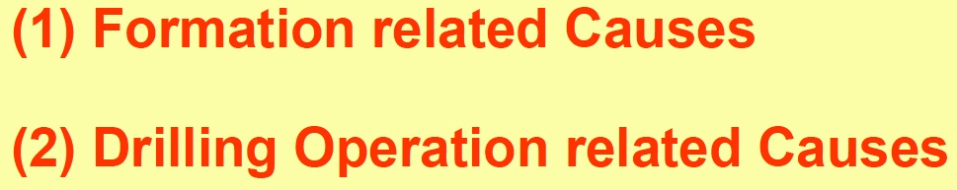
Causes of Stuck Drill String

Slide 4
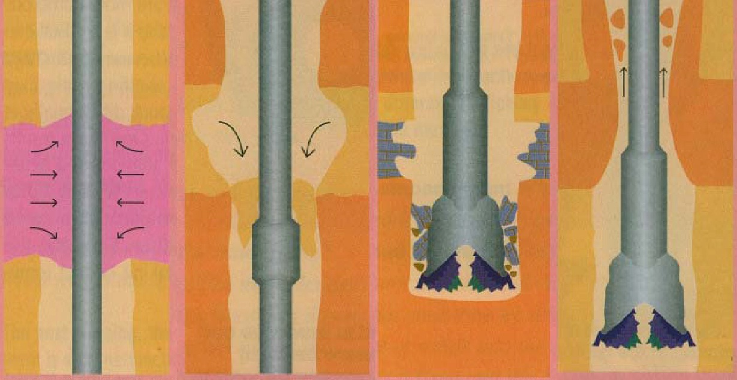
1. Formation Related Causes of Stuck Drill String
Mobile Formations
(salt, plastic shale)
Unconsolidated
Formations
(sands, gravels)
Fractured / Faulted
Formations
(fault/rubble zones)
Reactive Formations
(swelling clays)

Slide 5
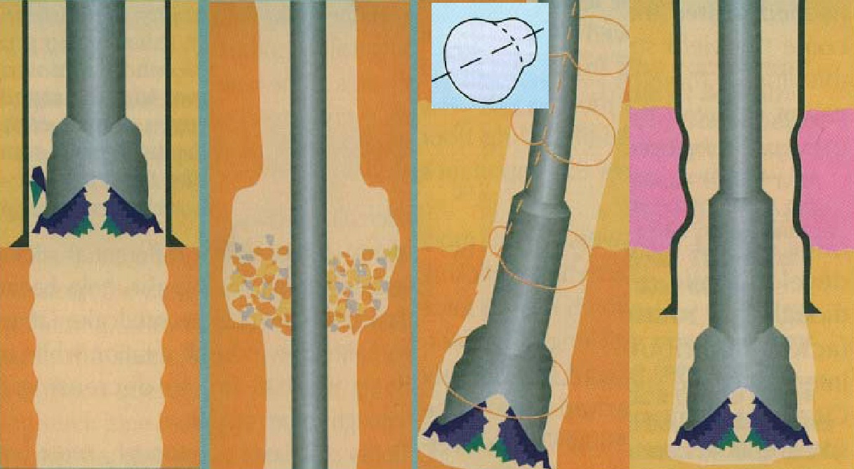
2. Drilling Operation Related Causes of Stuck Drill String
Junk in Hole
(lost roller cone)
Poor Hole
Cleaning
Keyseat in
Doglegs
Collapsed Casing

Slide 6
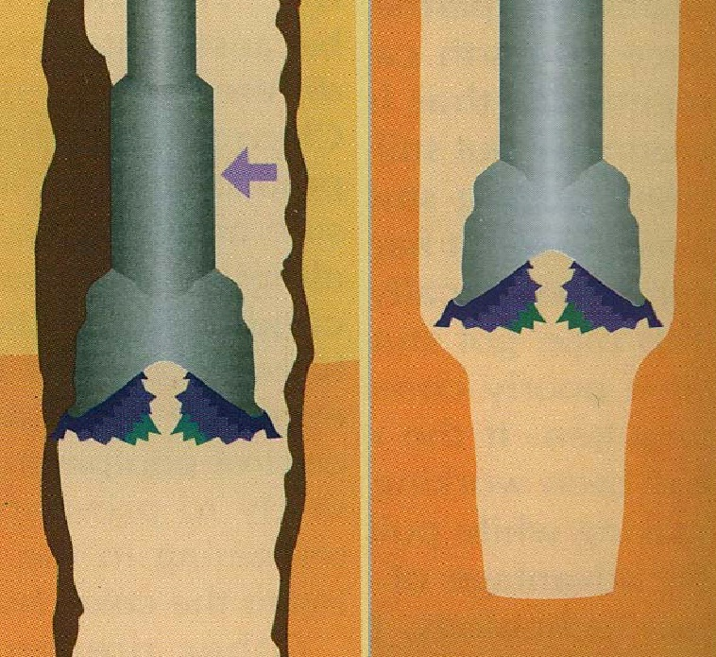
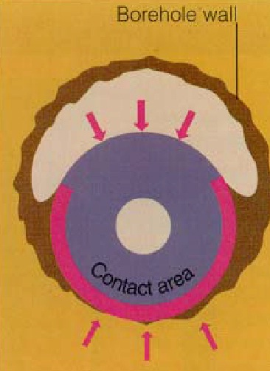
2. Drilling Operation Related Causes of Stuck Drill String
Differential Sticking
Mud Cake
Too Thick
Undergauge Hole
Worn Bit Gauge
Cement Related
Flash Setting
of Cement

Slide 7
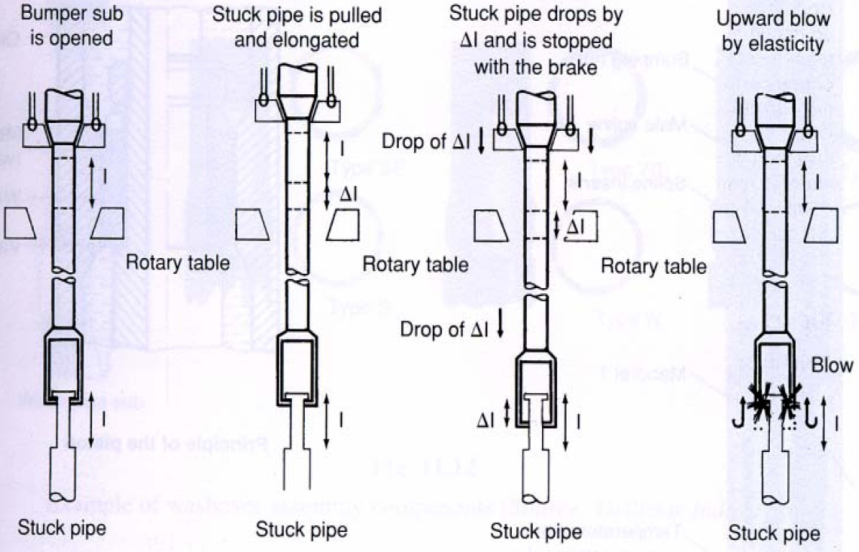
Principle of Jarring Operation

Slide 8
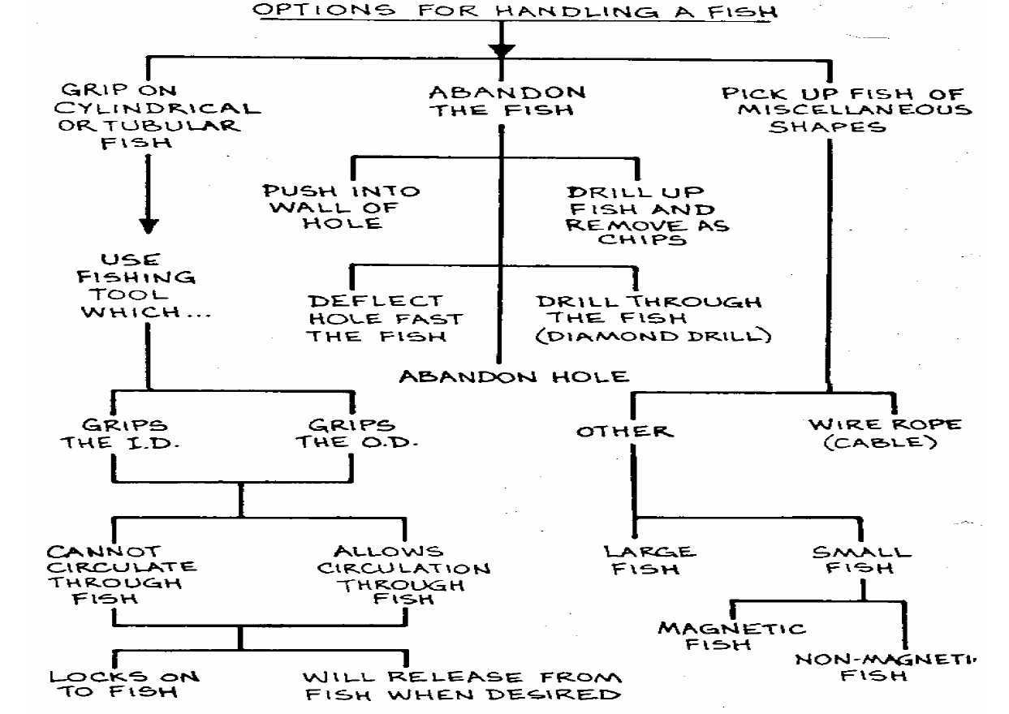

Slide 9
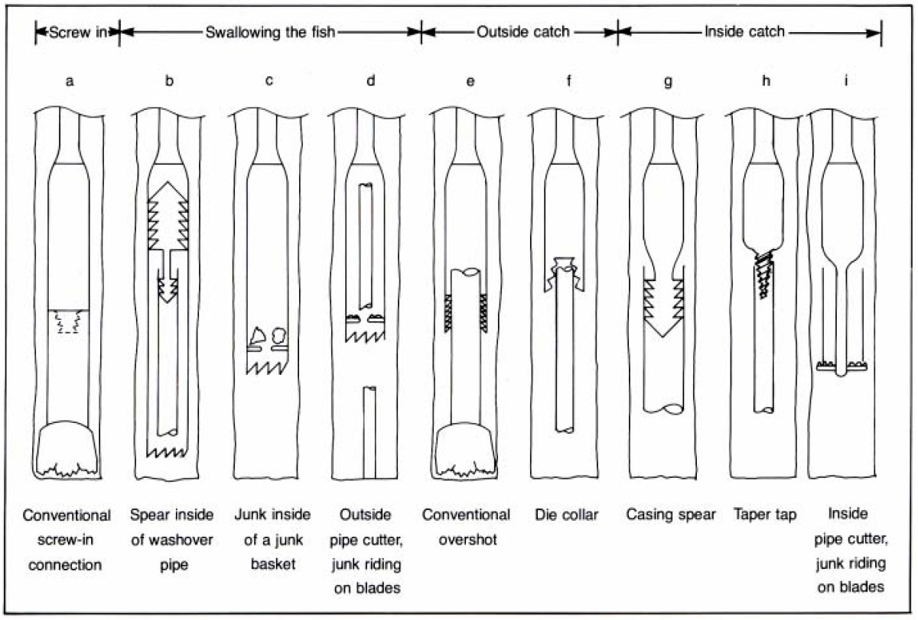
Techniques for Catching the Fish

Slide 10
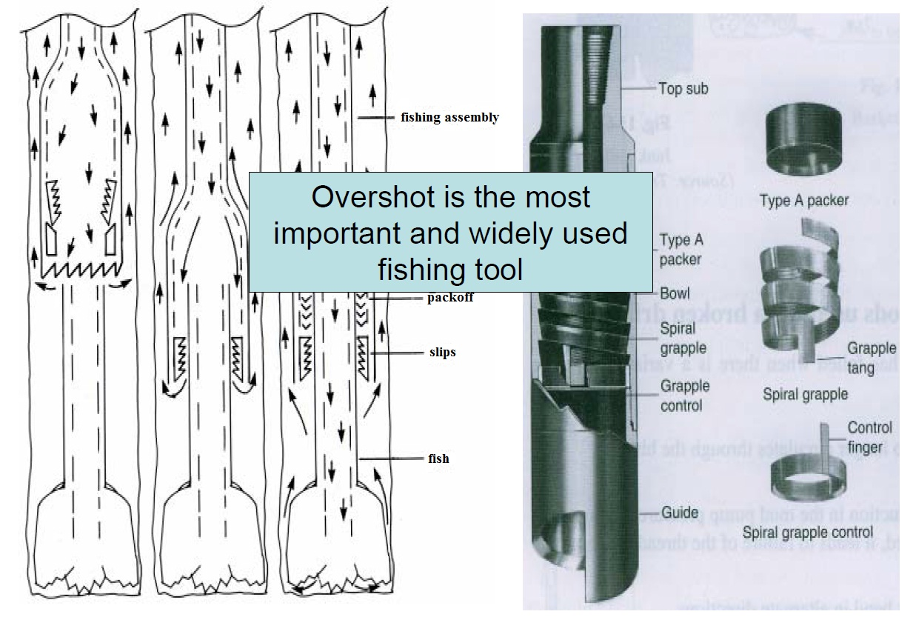
Principle of Overshot Operation

Slide 11
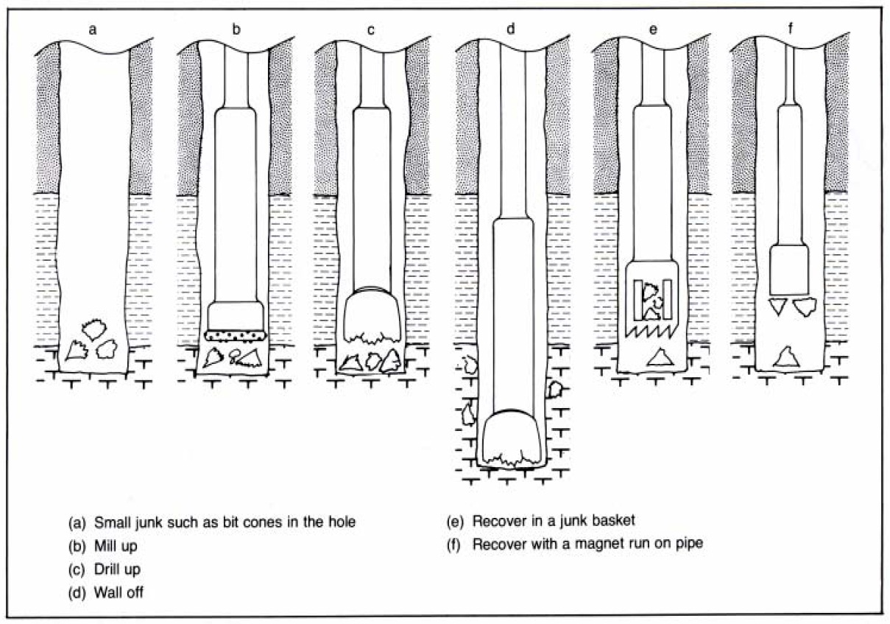
Recovering or Removing Small Junk

Slide 12
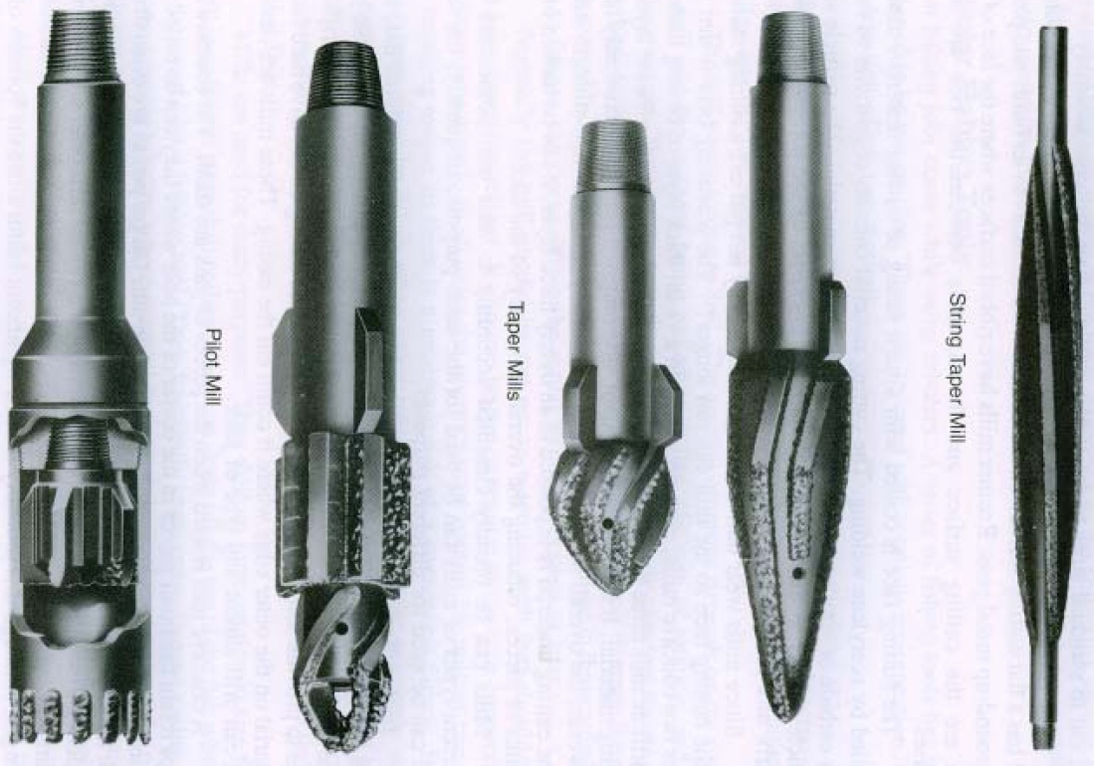
Various Types of Milling Tools

Slide 13
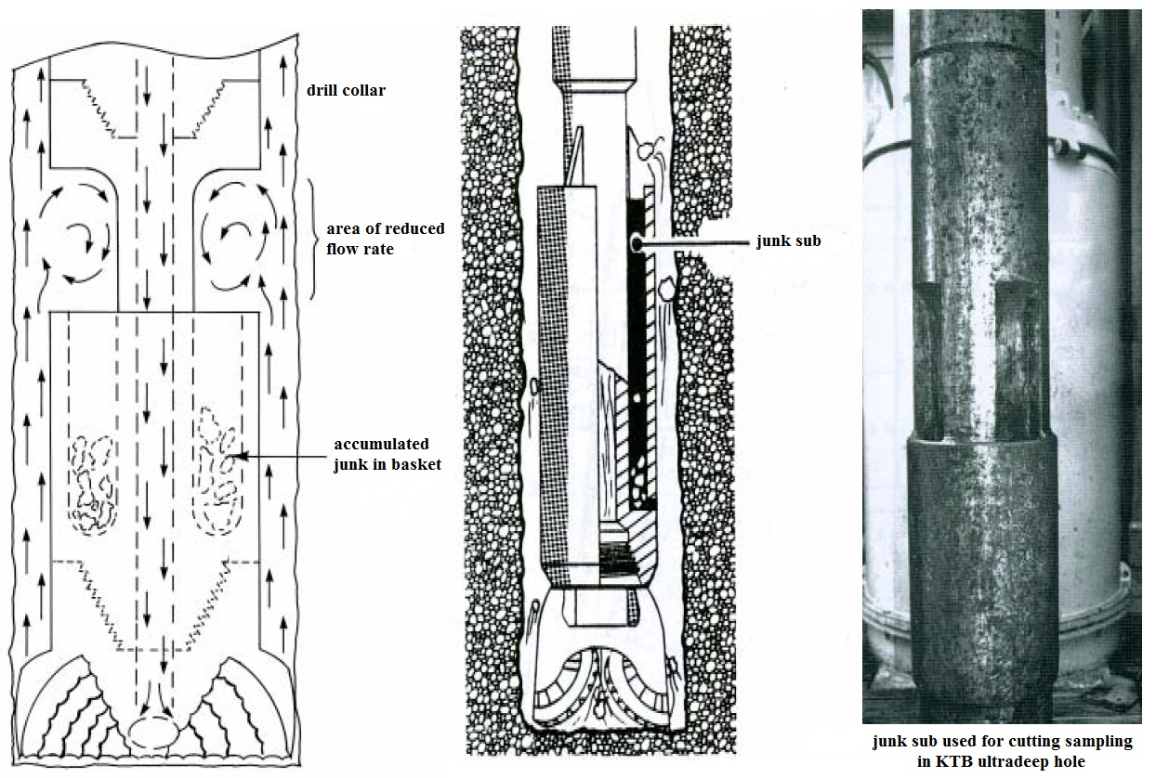
Working Principle of a Junk Sub

Slide 14
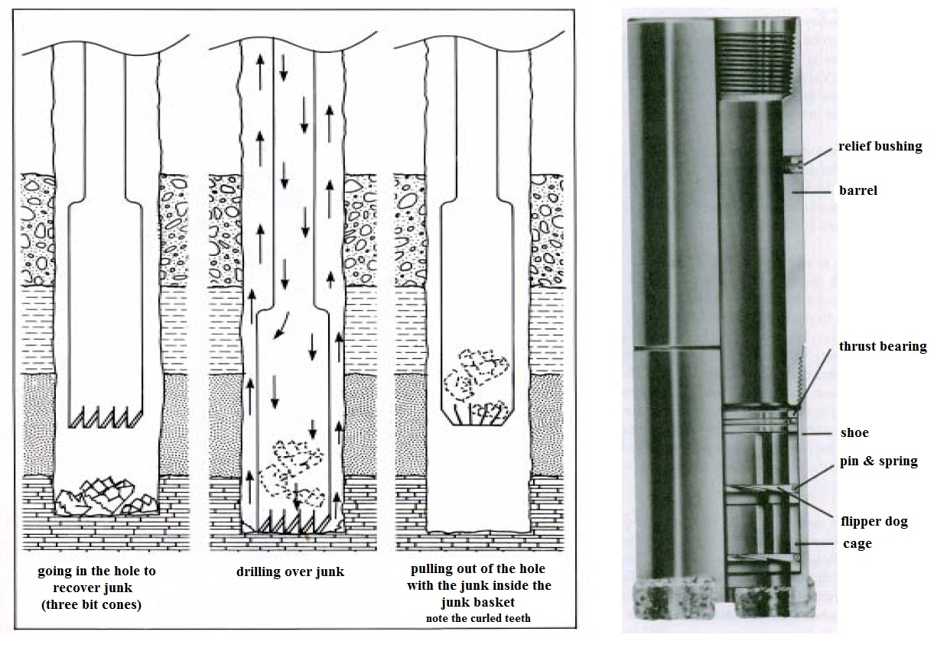
Catching Roller Cones with Junk Basket

Slide 15
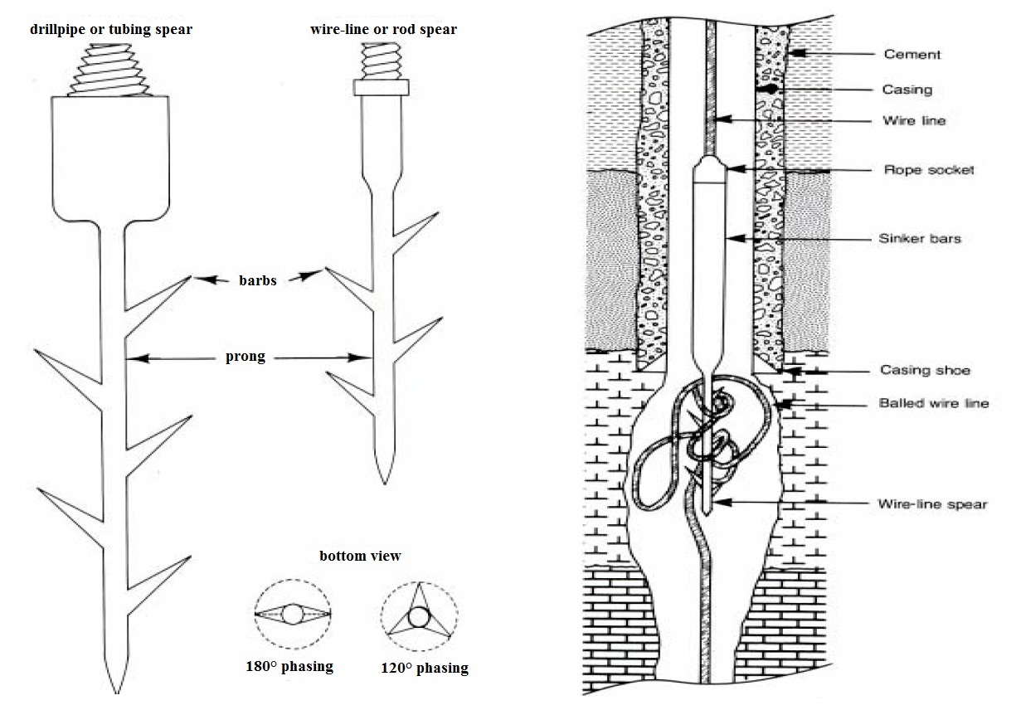
Catching Logging Cable with a Wire-Line Spear

Slide 16
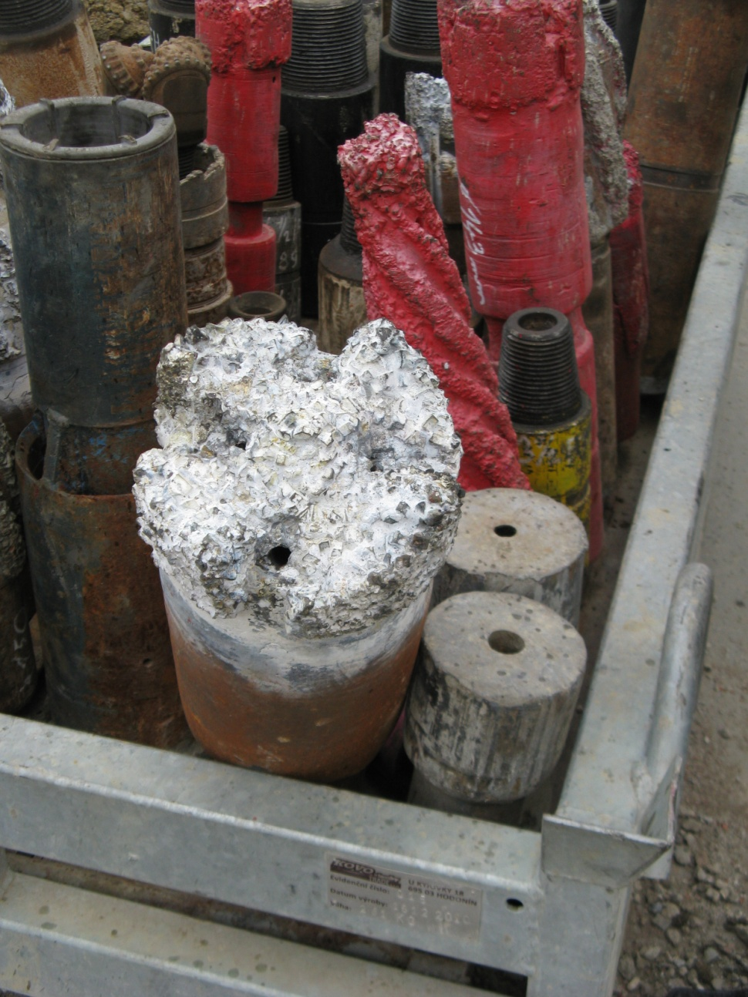
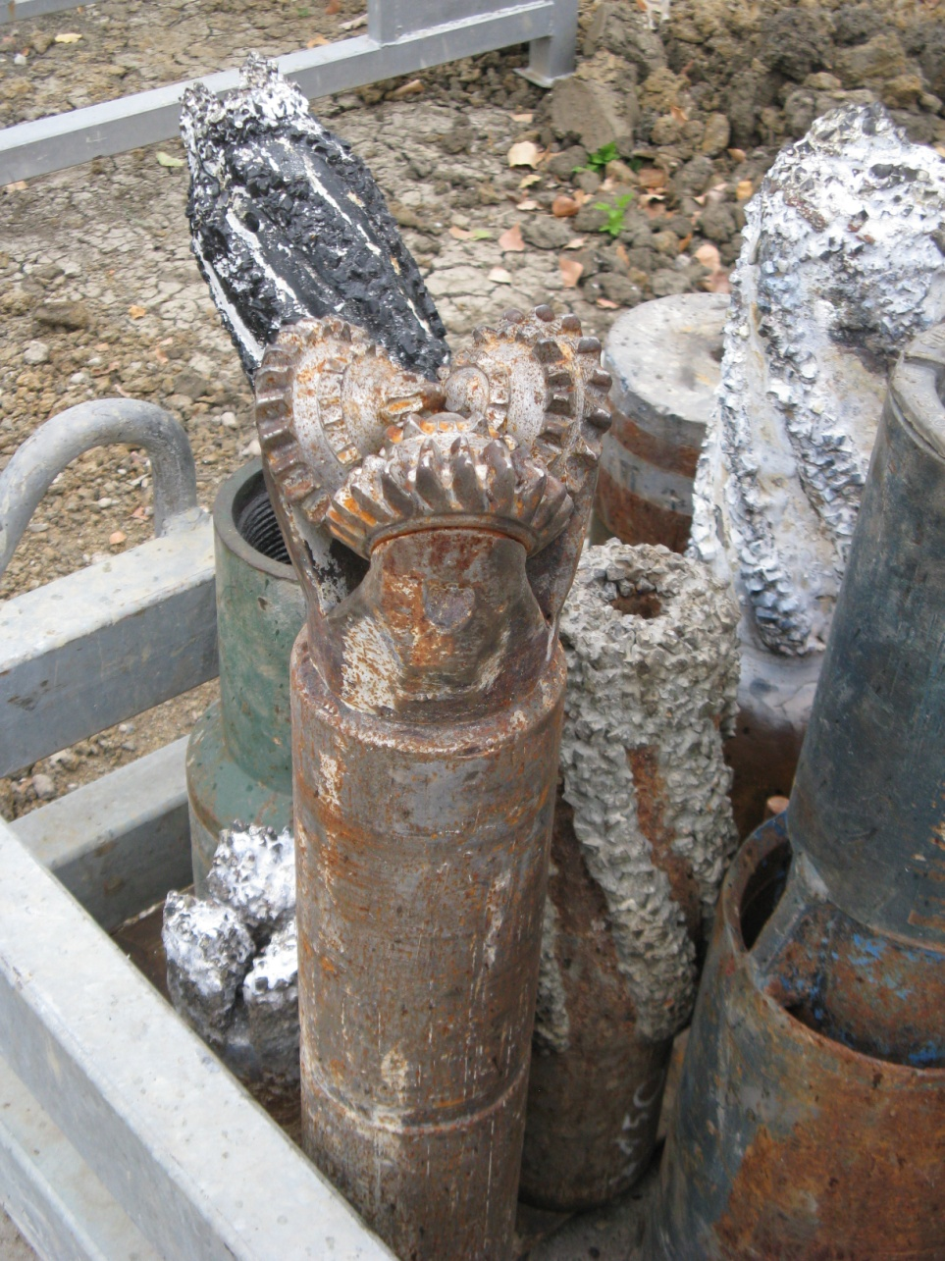
Fishing Tools

Slide 17
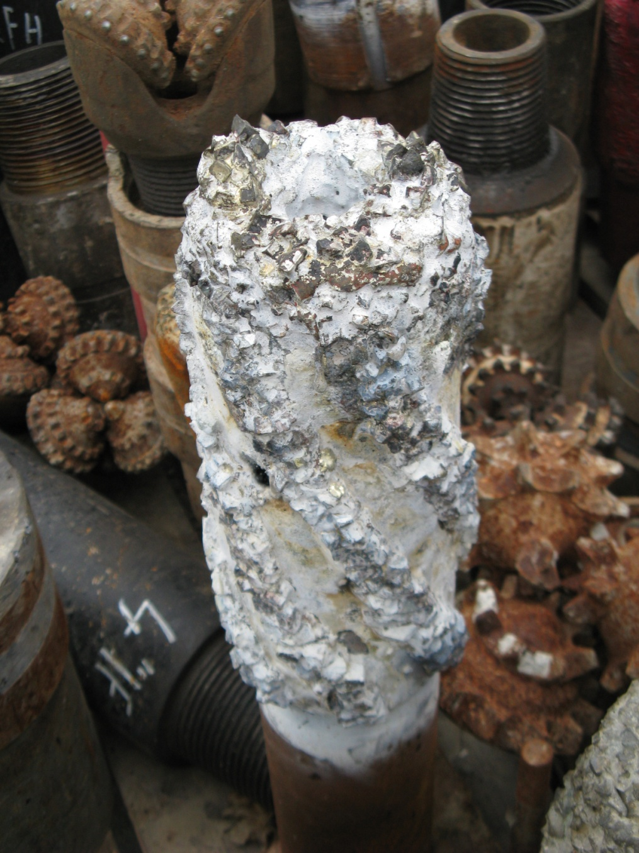
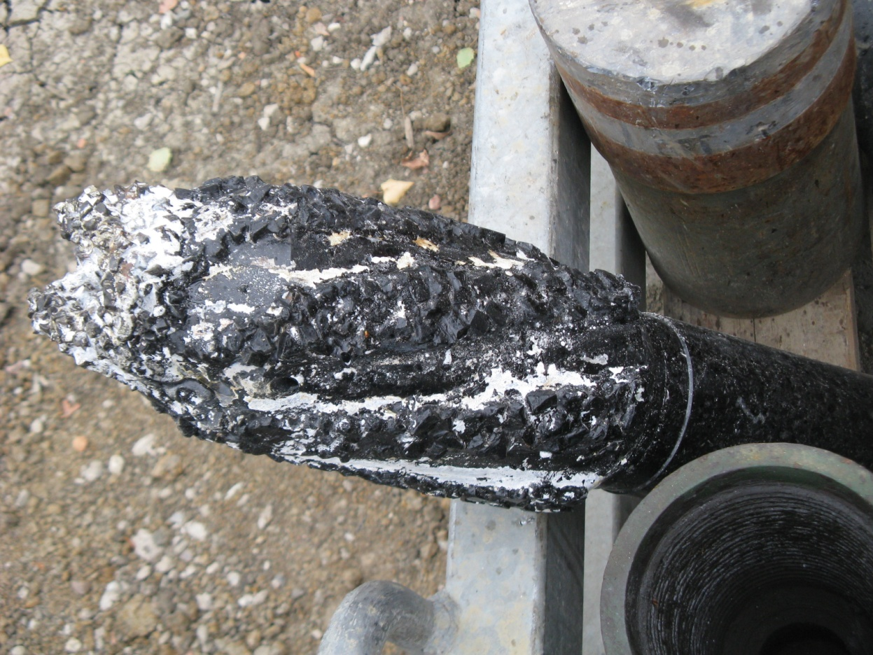
Fishing Tools

Slide 18
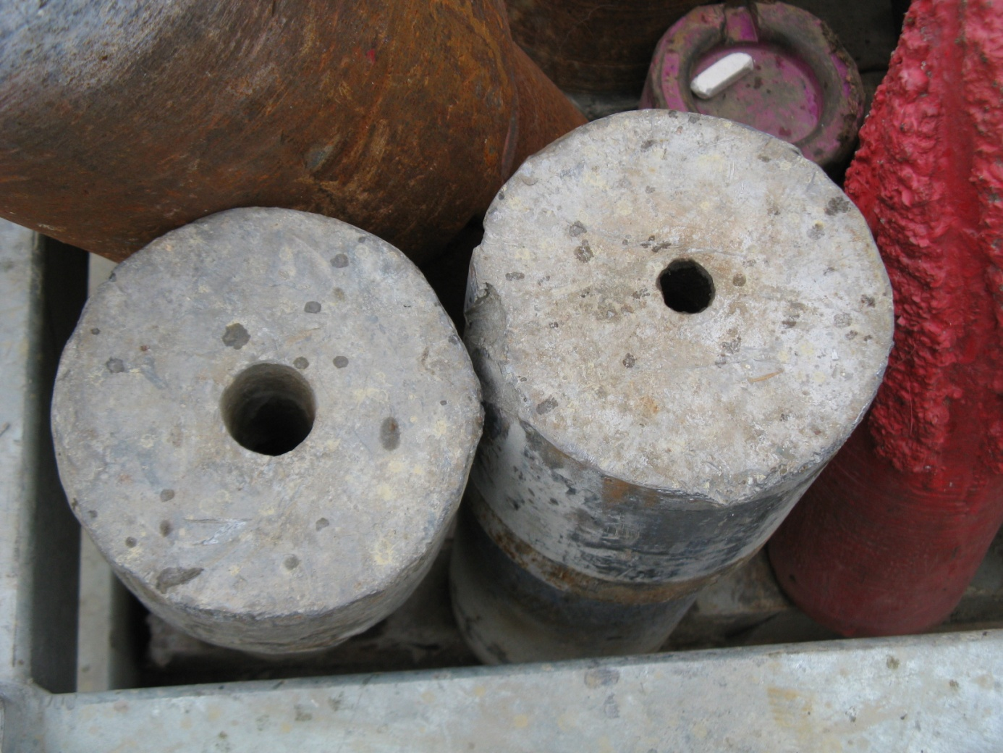
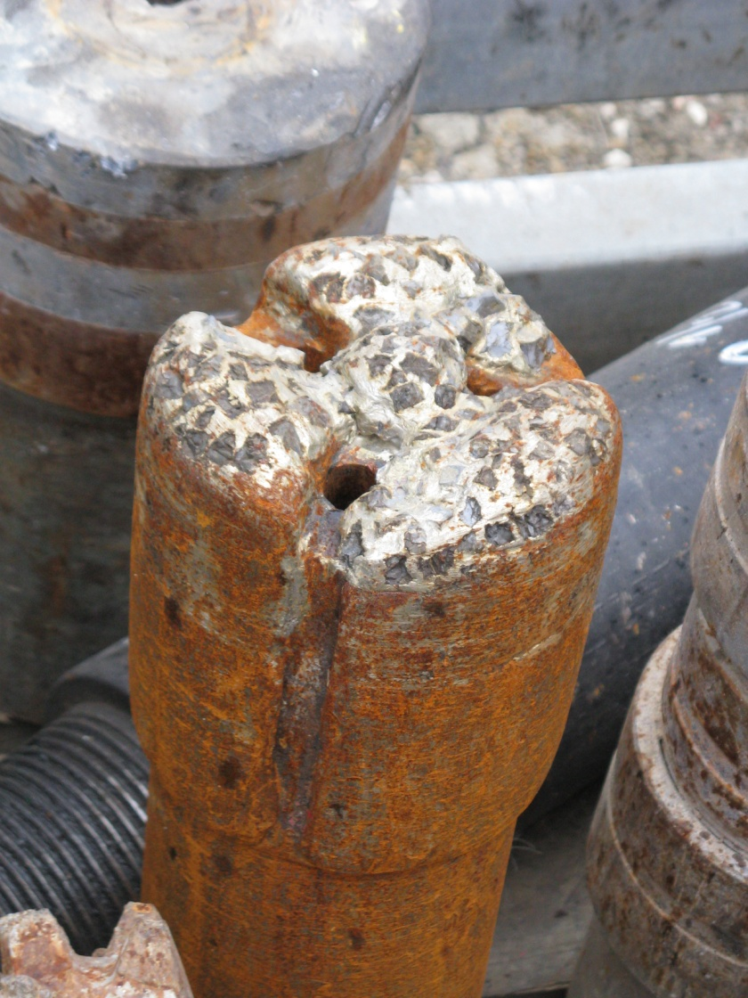
Fishing Tools

Slide 19

THE END!!!

Slide 20
Screwing / Unscrewing Drillpipe

